Slide 1

POWER
Matthew W. Wheeler

Slide 2
Power
If we are designing an experiment, we are spending money.
We want to have a reasonable probability (not assured) that we find something, if it exists.
power: The probability that we reject the null hypothesis in favor of our alternative.

Slide 3
Power depends upon:
The true state of nature, which in our case (for now) is the actual mean and the variance of the response. This is often called the effect size.
Our Type I error rate. If we are willing to make a type I error more frequently, our power increases.
Our sample size.
Our experimental design. Certain designs are “better.” (More on that later)

Slide 4
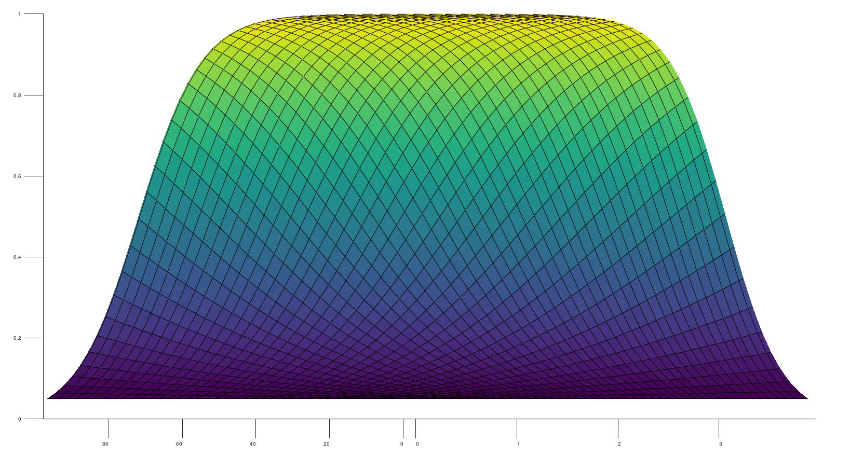
Multi-dimensional Power Curve
Power
N
Difference

Slide 5
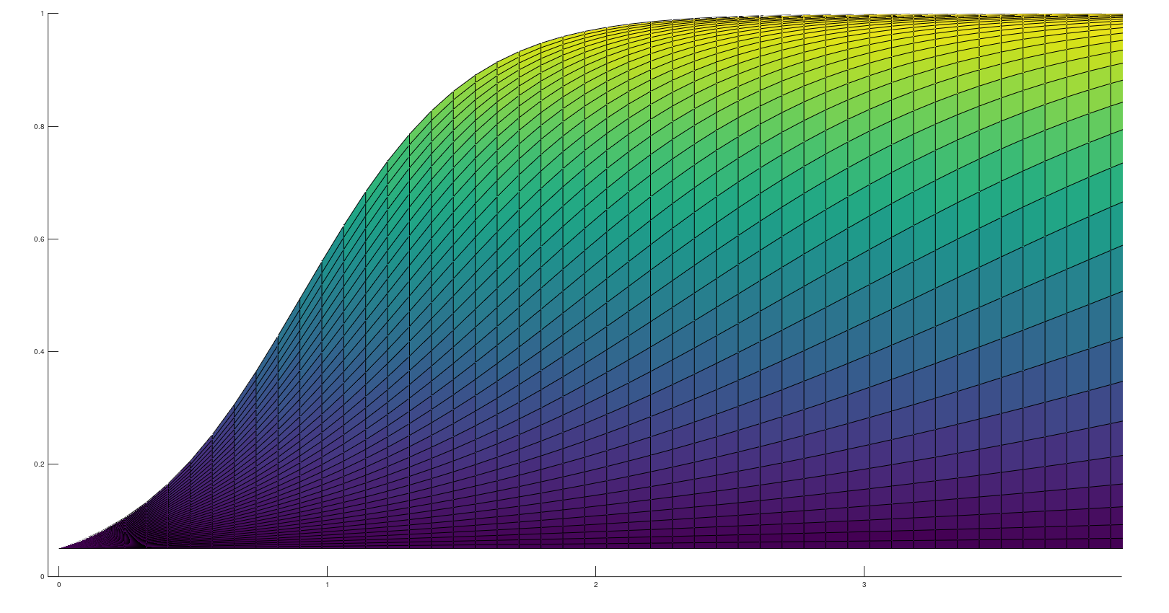
Power Based upon the Critical Effect
Power
Each Line is
A curve based upon a different sample size
Critical Effect

Slide 6
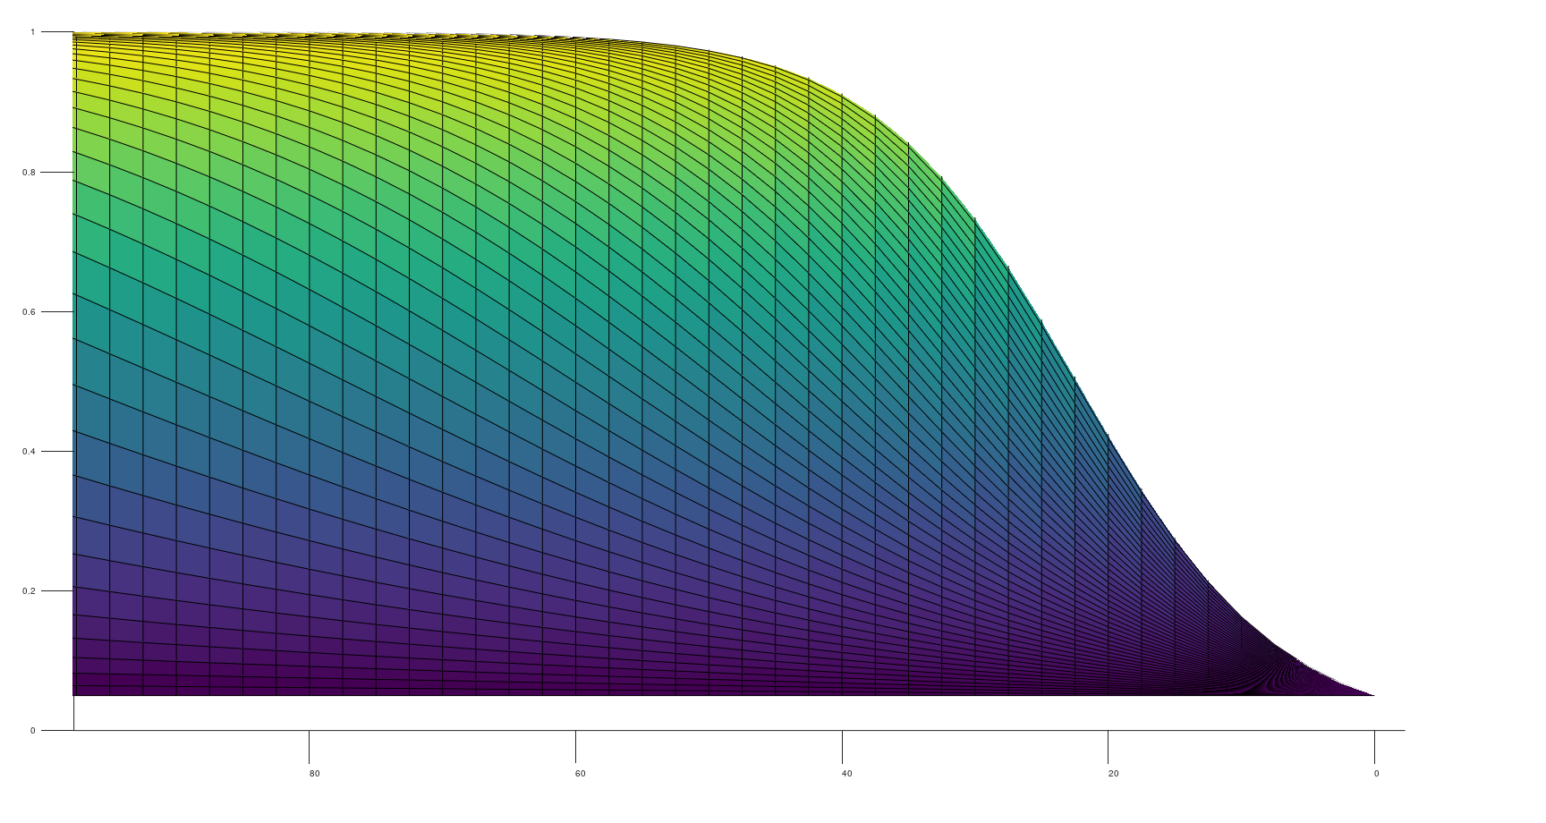
Power Based upon Sample Size
Each line is the power
Based upon a different
Critical effect.
Power
N

Slide 7
When designing a study, we can only control 2-4. We have to guess at 1.
SAS has two procs that help us with this:
proc power
and
proc glmpower
For more complicated experiments, we need to simulate the power.
We are going to focus on proc power now, and we will look at the other two later.

Slide 8
From SAS help
Syntax: POWER Procedure
The following statements are available in PROC POWER:
PROC POWER <options> ; <- invoking statement
LOGISTIC <options> ;
MULTREG <options> ; <- for regression analysis
ONECORR <options> ;
ONESAMPLEFREQ <options> ; <- simple test comparing proportions to a known quantity
ONESAMPLEMEANS <options> ; <- simple ttest comparing proportions to a known quantity
ONEWAYANOVA <options> ;
PAIREDFREQ <options> ;
PAIREDMEANS <options> ;
PLOT <plot-options> </ graph-options> ;
TWOSAMPLEFREQ <options> ; <- paired test for two proportions A/B testing conversions.
TWOSAMPLEMEANS <options> ; <-paired ttest for two unknown means.
TWOSAMPLESURVIVAL <options> ;
TWOSAMPLEWILCOXON <options> ;

Slide 9
We are going to focus on some of the above options with the goal of figuring out the sample size required to achieve a reasonable power.
Reasonable power is usually between 80% and 90%.
For clinical research involving humans or animals, a power of 80% is usually considered ‘ethical.’

Slide 10
Example 1
A marketing campaign has been designed to increase customer spending. Currently customers spend an average of $200 a month with a standard deviation of $20, the campaign is considered successful if customers spend $25 more a month. We are going to design an experiment to see if the campaign should be rolled out nationwide. How many people should be recruited to see if this effect is found with 90% probability?
Our analysis is a simple t-test.

Slide 11
PROC POWER;
ONESAMPLEMEANS TEST=t
NULLMEAN=200
MEAN=225
STDDEV=20
ALPHA=0.05
POWER=0.9
NTOTAL=.;
RUN;

Slide 12
Fixed Scenario Elements
Distribution | Normal
Method | Exact
Null Mean | 200
Alpha | 0.05
Mean | 225
Standard Deviation | 20
Nominal Power | 0.9
Number of Sides | 2
Computed N Total
Actual Power | N Total
0.906 | 9

Slide 13
Example 1 (continued)
Now assume we don’t know the standard deviation, it could be anywhere between 10 to 50.
STDDEV= 10 to 50 by 5

Slide 14
Computed N Total
Index | Std Dev | Actual Power | N Total
1 | 10 | 0.982 | 5
2 | 15 | 0.953 | 7
3 | 20 | 0.906 | 9
4 | 25 | 0.911 | 13
5 | 30 | 0.915 | 18
6 | 35 | 0.905 | 23
7 | 40 | 0.901 | 29
8 | 45 | 0.908 | 37
9 | 50 | 0.900 | 44

Slide 15
Example 1 (continued)
Now assume we can only afford to recruit 20 people. Do we have enough power?
Change
POWER=0.9 to POWER=.
and
NTOTAL=. to NTOTAL=20 ;

Slide 16
Computed Power
Index | Std Dev | Power
1 | 10 | >.999
2 | 15 | >.999
3 | 20 | >.999
4 | 25 | 0.989
5 | 30 | 0.942
6 | 35 | 0.858
7 | 40 | 0.755
8 | 45 | 0.655
9 | 50 | 0.565

Slide 17
Example 2
A web page site currently has a 5% conversions rate. The redesigned website is hoped to have a 7.5% conversion rate. What is the sample size required power is required to see if the new website has the desired effect?
Note: The data are proportion data, so we can do what is called an exact test.

Slide 18
PROC POWER;
ONESAMPLEFREQ
NULLP=0.05
P=0.075 TO 0.1 BY 0.005 /*VARY THE CRITICAL EFFECT FROM
0.075 TO 0.1*/
ALPHA=0.05
POWER= .
NTOTAL= 900;
PLOT X=N min=10 max=1000 yopts = (ref=0.90 crossref=yes)
;*PLOT THE POWER FROM 10 TO 1000;
RUN;

Slide 19
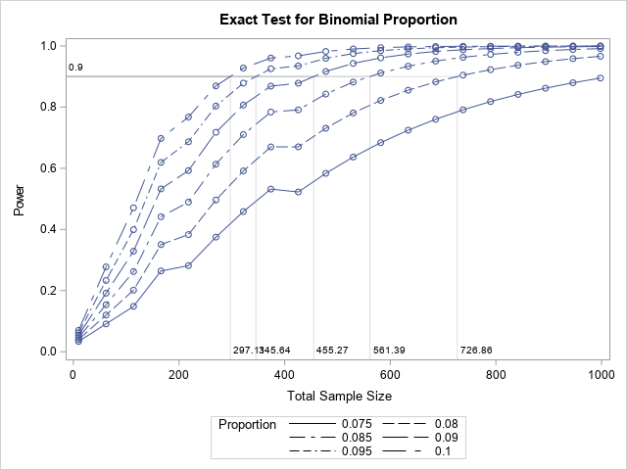

Slide 20
The Jagged curve is because the test is no longer an approximation (i.e. normal approximation), but it is based upon a different distribution. This is known as a saw tooth power function.
Until know we have assumed there is one unknown. Let’s assume there are two unknown means.

Slide 21
Example 3
A two different drugs are designed to lower cholesterol. We are interested in determining if the plasma total cholesterol is different between the two drugs. We know that the population serum total cholesterol is has a standard deviation of about 43 mg/dl in the general population.

Slide 22
*EXAMPLE 1;
*WHAT WE REALLY CARE ABOUT IS A DIFFERENCE IN THE MEAN
* WE DON'T HAVE TO SPECIFY EACH MEAN INDIVIDUALLY;
* QUESTION WHAT IS MY POWER WHEN I CHANGE N OVER THE RANGE
* 20 TO 100;
PROC POWER;
TWOSAMPLEMEANS
MEANDIFF = 0 TO 10 BY 2
STDDEV = 40
ALPHA = 0.05
POWER = .
NTOTAL = 20 TO 100 BY 20;
PLOT X=N min=10 max=100 yopts = (ref=0.90 crossref=yes);
RUN;
END;

Slide 23
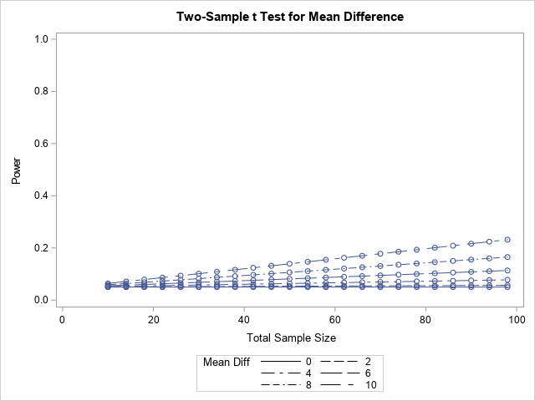
My power up to a sample of 100 is pretty low.

Slide 24
What if one drug not only reduces total Cholesterol but also decreases the variability of the response?
*COMPARE THE NORMAL TEST ABOVE TO THE CASE
*WHEN THERE IS UNEQUAL VARIANCES
*;
PROC POWER;
TWOSAMPLEMEANS TEST=diff_satt /*satterthwaite approximation unequal variances*/
MEANDIFF = 0 TO 10 BY 2
GSTDS = (40,30)
ALPHA = 0.05
POWER = .
NTOTAL = 20 TO 100 BY 20;
PLOT X=N min=10 max=100 yopts = (ref=0.90 crossref=yes);
RUN;
END;

Slide 25
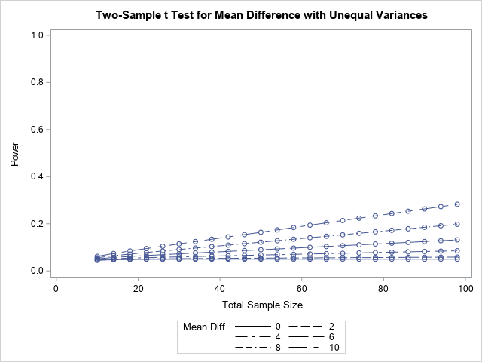

Slide 26
We want 80% power
*WE DON'T HAVE A LOT OF POWER, WHAT IS OUR SAMPLE
SIZE IF WE WANT 80% POWER?;
PROC POWER;
TWOSAMPLEMEANS TEST=diff_satt /*Satterthwaite approximation unequal variances*/
MEANDIFF = 2 TO 10 BY 8
GSTDS = (40,30)
ALPHA = 0.05
POWER = .80
NTOTAL = .;
RUN;
END;

Slide 27
If we want to detect a difference of 2, we need a ton of people!
The question becomes is it worth it?
Computed N Total
Index | Mean Diff | Actual Alpha | Actual Power | N Total
1 | 2 | 0.05 | 0.800 | 9814
2 | 10 | 0.05 | 0.801 | 396

Slide 28
Example 4
The color of text on a website is thought to change the behavior of customers clicking on add links. Given there are 20 million customers visiting each week and an extra 5 cents in add revenue for every click, a difference of 0.005% is considered important. What is the power needed to detect this difference if:
The conversion rate is approximately 0.5% for the ‘least popular color’

Slide 29
/*EXAMPLE 4*/
*ONE WAY TO THINK ABOUT IT IS A ONE SAMPLE TEST
*
*;
PROC POWER;
ONESAMPLEFREQ METHOD=NORMAL TEST= ADJZ /*SAMPLE SIZES ARE GOING TO BE BIG WE CAN APPROXIMATE USING THE NORMAL*/
NULLP= 0.005 TO 0.01 BY 0.005
P = 0.01 TO 0.015 BY 0.005
ALPHA = 0.05
POWER = .90
NTOTAL = .;
RUN;
END;

Slide 30
Computed N Total
Index | Null Proportion | Proportion | Actual Power | N Total | Error
1 | 0.005 | 0.010 | 0.900 | 3017
2 | 0.005 | 0.015 | 0.900 | 957
3 | 0.010 | 0.010 | . | . | Invalid input
4 | 0.010 | 0.015 | 0.900 | 5117
Why?

Slide 31
On proportions:
The power changes with the proportion (Why?)
Make sure you know what formula you are using when doing the comparison, this will change your power result.
The problem above is that we are assuming one mean is known, so it doesn’t really work, and will way underestimate our sample size.
The ‘twosamplefreq’ will give you the correct answer.
When you are dealing with multiple proportions you are going to want to uses something like logistic regression, but power becomes a bit more complicated as we will see in lecture 8.

Slide 32
THE CORRECT WAY TO DO IT:
/*WE HAVE THIS WONDERFUL TWO SAMPLE FREQ
PROCEDURE CAN WE DO SOMETHING MORE CORRECT*/
PROC POWER;
TWOSAMPLEFREQ TEST=PCHI
refproportion=.01 /* reference proportion is 0.01*/
proportiondiff=.005 /* increased conversion is 0.005*/
sides=1 2
alpha=.05
power=.9
NTOTAL=.;
RUN;

Slide 33
Computed N Total
Index | Sides | Actual Power | N Total
1 | 1 | 0.900 | 16910
2 | 2 | 0.900 | 20748
The reality is we are NOT comparing one proportion to a KNOWN value so our N is much higher.

Slide 34
BUT A DIFFERENCE IN THE BACKGROUND PROPORTION
RATE IS A BIG DEAL!
/*WHAT HAPPENS WHEN WE INCREASE THE REFERENCE PROPORTION
*/
PROC POWER;
TWOSAMPLEFREQ TEST=PCHI
refproportion=.1 /* reference proportion is 0.1*/
proportiondiff=.005 /* increased conversion is 0.005*/
sides=1 2
alpha=.05
power=.9
NTOTAL=.;
RUN;

Slide 35
Computed N Total
Index | Sides | Actual Power | N Total
1 | 1 | 0.900 | 126048
2 | 2 | 0.900 | 154656
Now our sample sizes are almost 10x higher!

Slide 36
More notes on proportions:
Making mistakes in assumptions for normal data won’t affect your power by as much as it will a proportion.
Proportions variability change with the true value.
- This variability goes down the further the proportion gets away from 0.5, which is the point of maximum variability.
If you can get away with not looking at the data as dichotomous,
you are always in better shape.

Slide 37
Example 5:
Whale strikes happen when boats hit a whale. When they occur it is fatal for the whale. The coast guard is considering changing its rules in a particular sound in Alaska to protect the whales, but it wants to know if its new protocol will change the risk. The probability of hitting a whale is currently about 0.001 percent with the present protocol.
Let’s say a difference of 0.0005 is important.

Slide 38
/*Example 5 HITTING A WHALE*/
ODS HTML STYLE=HTMLBLUECML;
PROC POWER;
TWOSAMPLEFREQ TEST=PCHI
refproportion=0.001
proportiondiff=0.005
sides=1
alpha=0.05
power=0.6 0.8 0.99
groupweights= (1 1) (1 2) (1 3) /*CONTROL THE SAMPLE SIZE ALLOCATION*/
NTOTAL=.;
PLOT Y=POWER YOPTS=(REF=0.8 CROSSREF=YES)
VARY(SYMBOL BY GROUPWEIGHTS);
RUN;

Slide 39
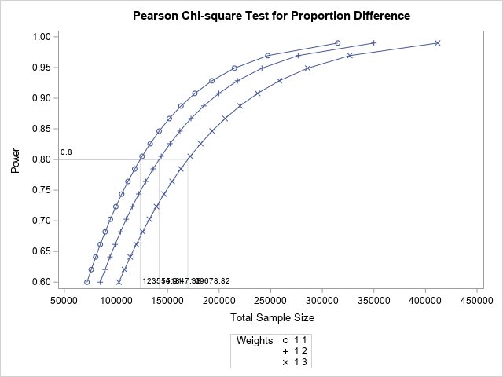

Slide 40
Now if there are only 10,000 boats per year we have about 10 to 20 years to see if the protocol is going to make a difference!
Try to convince someone of this experiment if it costs money!

Slide 41
Different way to think about it
Let’s define a boat hit as the Whale getting below 20ft, so we can define the problem as a continuous variable. Given it is a big sound, and whales probably stay far away from boats, let’s say that observations are log-normally distributed. That is the log of distances is normally distributed with standard deviation 1.
As log(20) is approximately 3. We are arguing our current log mean is 6.1 as the probability a z-score of 3.1 has the probability of 0.001.

Slide 42
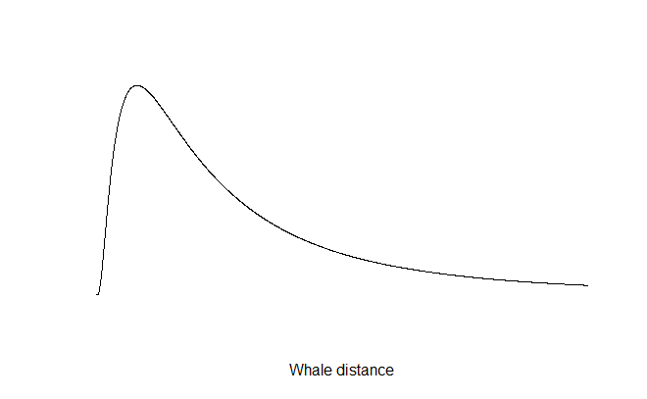
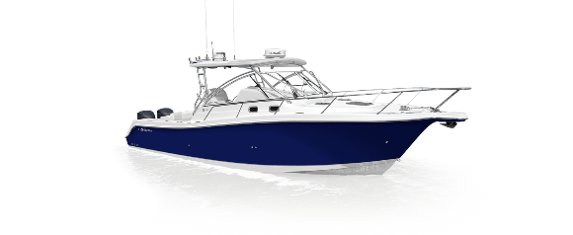
How we can think about it visually

Slide 43
As log(20) is approximately 3. We are arguing our current log mean is 6.1 as the probability a z-score of 3.1 has the probability of 0.001.
Use pnorm(3.1) in R to see
We want to shift the log mean to have a probability of 0.0005, which implies the log mean is 6.29

Slide 44
/*Change the variable to a continuous variable
assuming the log of the distance is normally distributed
now what do we get? */
PROC POWER;
TWOSAMPLEMEANS
MEANDIFF = 0.19
STD = 1
ALPHA = 0.05
POWER = 0.6 .80 0.99
NTOTAL = .;
PLOT Y=POWER YOPTS=(REF=0.8 CROSSREF=YES);
RUN;

Slide 45
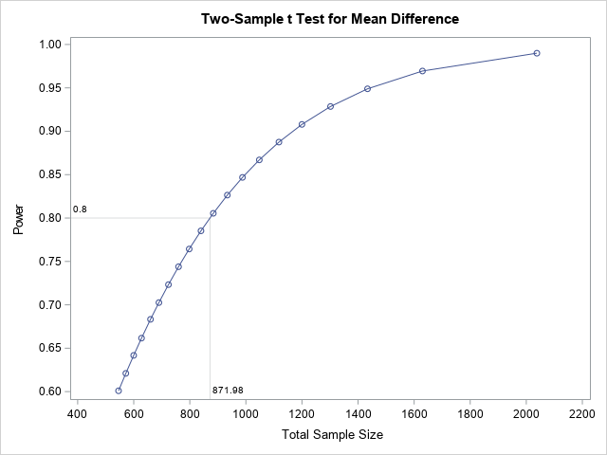

Slide 46
Now
All you have to do is wait a month to see if the new protocol is increasing the distance and thus lowering the probability of a Whale strike.
Which one do you choose?
In an experiment, what you measure has all the difference in the world.

